Slide 1
Tensile
Feb 26, 2016

Slide 2
motivation
GEMM API encapsulates trillion of problems. All behave differently on GPUs
Precisions, Transpose A, Transpose B, M, N, K, Strikdes
Many problem types behave similar to GEMM
𝐶𝑖𝑗 = 𝑘 𝐴𝑖𝑘 ∗ 𝐵𝑘𝑗 (gemm NN)
𝐶𝑖𝑗𝑘 = 𝑙 𝐴𝑖𝑙𝑘 ∗ 𝐵𝑗𝑙𝑘 (batched gemm NT)
𝐶𝑖𝑗𝑘 = 𝑙𝑚𝑛 𝐴𝑖𝑙𝑚𝑛𝑘 ∗ 𝐵𝑗𝑙𝑚𝑛𝑘 (batched gemm w/ 3D summation)
𝐶𝑖𝑗𝑘 = 𝑙𝑚𝑛 𝐴𝑖𝑛𝑙𝑘𝑚 ∗ 𝐵𝑚𝑗𝑙𝑘𝑛 (batched gemm w/ 3D summation different data layout)
Goal: auto-generate kernels which achieve peak performance
For all problem types.
For all problem sizes.
On all GPUs.
Multiple languages: OpenCL, HIP, Assembly.

Slide 3
Problem 术语
example problem
C[i,j] = Sum[k] A[i,k] * B[k,j] (GEMM; 2 free indices and 1 summation index)
C[i,j,k] = Sum[l] A[i,l,k] * B[l,j,k] (batched-GEMM; 2 free indices, 1 batched index and 1 summation index)
C[i,j] = Sum[k,l] A[i,k,l] * B[j,l,k] (2D summation)
C[i,j,k,l,m] = Sum[n] A[i,k,m,l,n] * B[j,k,l,n,m] (GEMM with 3 batched indices)
C[i,j,k,l,m] = Sum[n,o] A[i,k,m,o,n] * B[j,m,l,n,o] (4 free indices, 2 summation indices and 1 batched index)
C[i,j,k,l] = Sum[m,n] A[i,j,m,n,l] * B[m,n,k,j,l] (batched image convolution mapped to 7D tensor contraction)
Free indices
Tensor C的indices, 成对出现，分别来源于tensor A和tensor B
比如i/j/k/l有4个 free indices, i/k来源A, j/l来源B
Batch indices
Tensor C的indices, 来源于tensor A和tensor B共同的indices，比如k
Bound/Summation indices
没有出现在Tensor C ， 而出现在summation symbol(Sum[k]和tensor A和tensor B)

Slide 4
General kernel-level 策略 - TILING
Tiling at all memory levels to read from lower-bandwidth memory less and from higher-bandwidth memory more to prevent bandwidth from being bottleneck

Slide 5
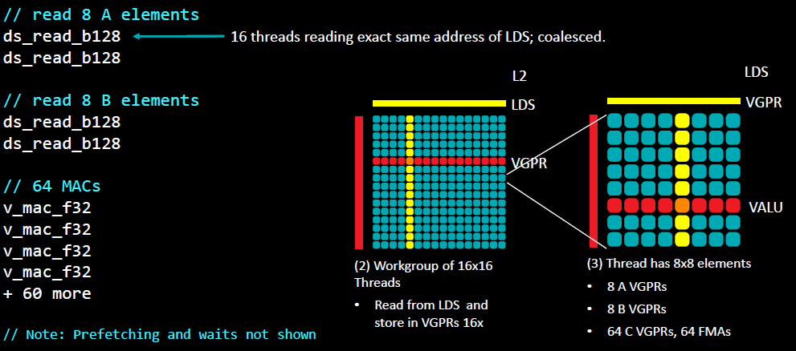
Thread-tile sub-iteration

Slide 6
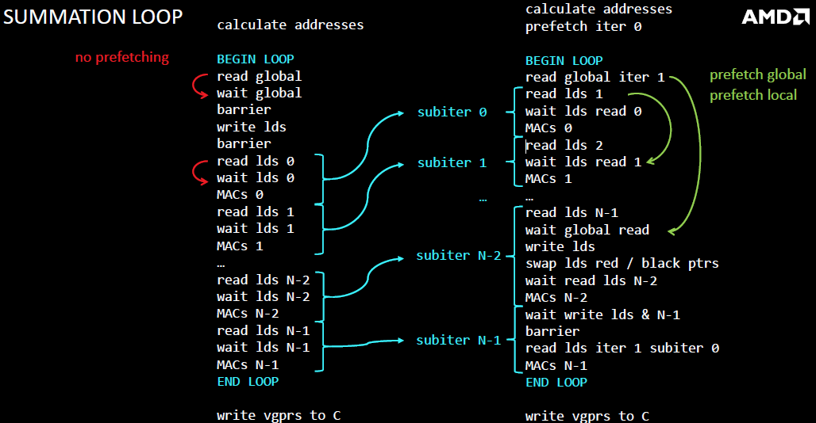

Slide 7
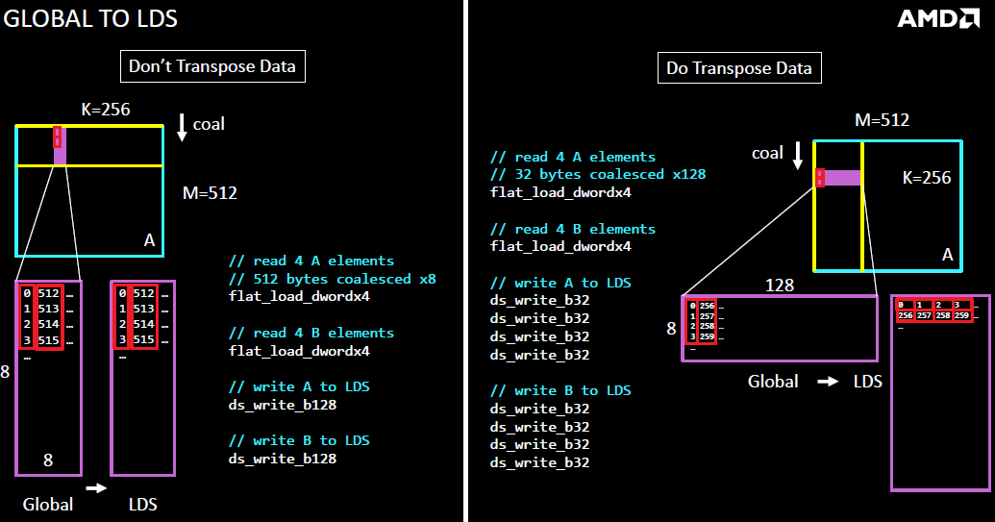

Slide 8
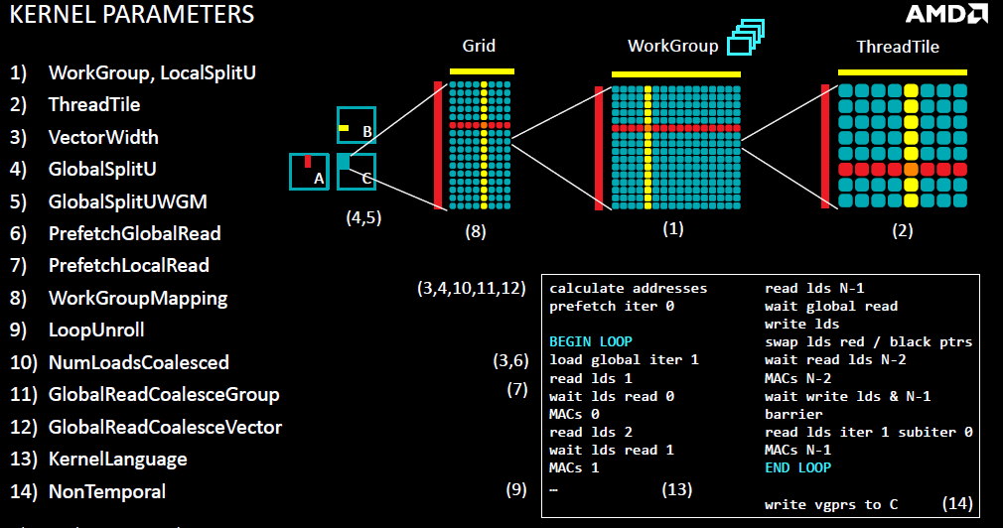

Slide 9
GPU Performance parameters
Compute Throughput
13.1 TFlops = 2 (flops/cycle)*64(CUs)*64(lanes/CU)*1600MHz
Global Memory Bandwidth
480 GB/s
coalescing
Global Memory Latency
hundreds of cycles
hide using CU-occupancy or ILP
CU Occupancy
resources (VGPRs, LDS) permitting, multiple workgroups are concurrently scheduled on CU
Whole-GPU Occupancy
need enough total workgroups to fill up the GPU
Caches
L2 shared by all CUs
L1 dedicated to CU
LDS Bandwidth
TB/s
LDS Latency
tens of cycles
hide using CU-occupancy or ILP
LDS Size
64 kB / CU
Instruction Divergence
all threads within workgroup do same instruction else need to compute and apply execution masks
Instruction Throughput
gemm requires 2*M*N*K instructions, all extras hurt efficiency
‒ minimize instructions which don’t count
maximize dual-issuing of instructions which don’t count with instructions that do; must be from different wavefronts
VALU, SALU, LDS, global memory, branch
Power
VALU, LDS, memory, caches

Slide 10
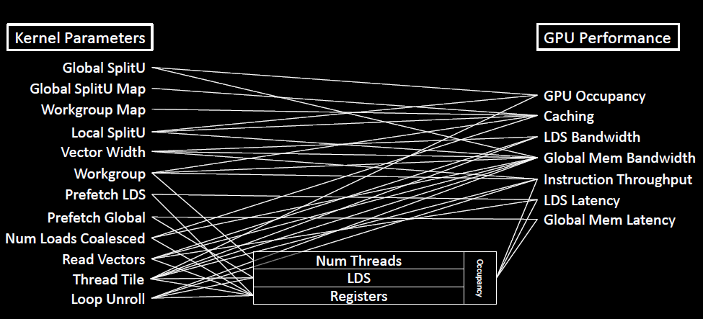
KERNEL PARAMETERS AFFECT GPU PERFORMANCE

Slide 11
N-Dimensional Tensor Contractions 映射到 Finite-Dimensional GPU Kernels
How N-Dimensional Tensor Contractions Are Mapped to Finite-Dimensional GPU Kernels
传统GEMM: 2维输出C[i,j], 启动2维Workgroups. 每个workgroup也是两维；一维的summation在kernel的body的loop中。
Special Dimensions: D0, D1 and DU
D0 and D1 are the free indices of A and B (one belongs to A and one to B) which have the shortest strides.
DU represents the summation index with the shortest combined stride (stride in A + stride in B);
There can be multiple summation indices (i.e. embedded loops) and DU will be iterated over in the inner most loop.
GPU Kernel Dimension
Tensile assigns D0 to be dimension-0 of the work-group and work-item grid; it assigns D1 to be dimension-1 of the work-group and work-item grids
All other free or batch dimensions are flattened down into the final dimension-2 of the work-group and work-item grids

Slide 12
Problem Type Parameters
OperationType: GEMM or TensorContraction.
DataType: s, d, c, z, h
UseBeta: False means library/solutions/kernel won't accept a beta parameter; thus beta=0.
UseInitialStrides: False means data is contiguous in memory.
HighPrecisionAccumulate: For tmpC += a*b, use twice the precision for tmpC as for DataType. Not yet implemented.
ComplexConjugateA: True or False; ignored for real precision.
ComplexConjugateB: True or False; ignored for real precision.
For OperationType=GEMM only:
TransposeA: True or False.
TransposeB: True or False.
Batched: True or False.
For OperationType=TensorContraction only (showing batched gemm NT: C[ijk] = Sum[l] A[ilk] * B[jlk]):
TransposeA: True or False.
TransposeB: True or False.
Batched: True or False.

Slide 13
Tensile benchmark config
ProblemType of C[ij] = Sum[k] A[ik]*B[jk], the ProblemSizes elements represent [SizeI, SizeJ, SizeK]. For each index, there are 5 ways of specifying the sizes of that index:
BenchmarkProblems:
- # sgemm
- # Problem Type
OperationType: GEMM
- # Benchmark Size-Group
InitialSolutionParameters:
- WorkGroup: [ [ 16, 16, 1 ] ]
- NumLoadsCoalescedA: [ 1 ]
- NumLoadsCoalescedB: [ 1 ]
- ThreadTile: [ [ 4, 4 ] ]
BenchmarkCommonParameters:
- ProblemSizes:
- Range: [ [512], [512], [512] ]
- EdgeType: ["Branch", "ShiftPtr"]
PrefetchGlobalRead: [False, True]
[1968]
Benchmark only size 1968; n = 1.
[16, 1920]
Benchmark sizes 16 to 1968 using the default step size (=16); n = 123
[16, 32, 1968]
Benchmark sizes 16 to 1968 using a step size of 32; n = 61

Slide 14
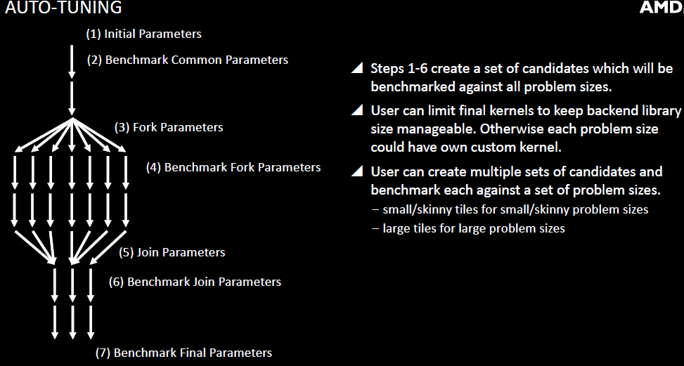

Slide 15
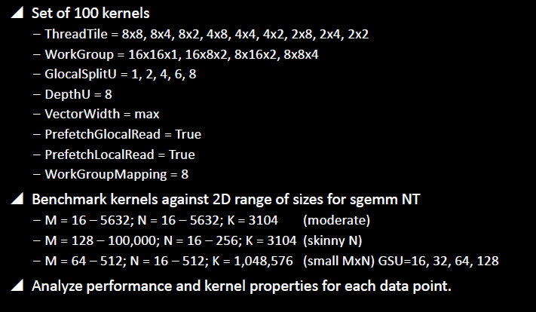
PERFORMANCE EXPERIMENTS

Slide 16
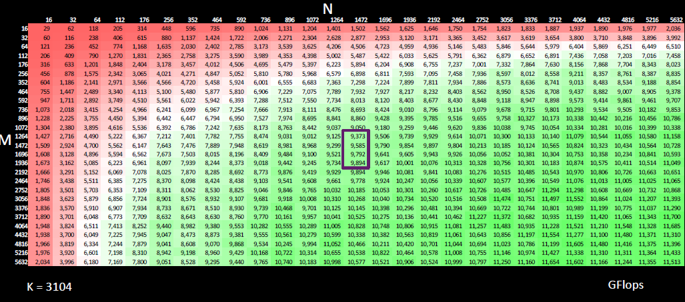
performance

Slide 17
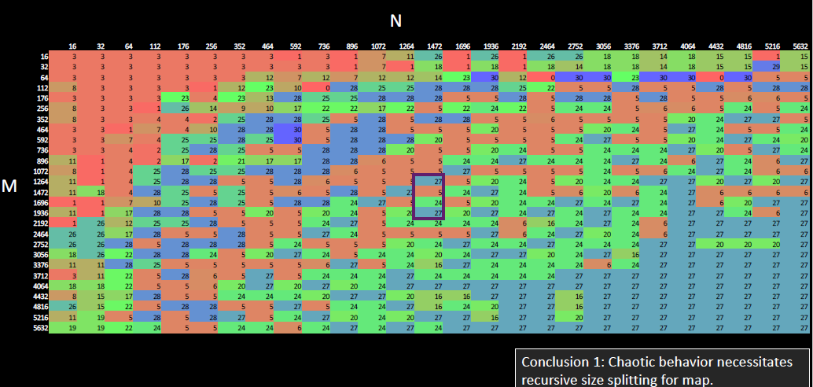
Winners

